Slide 1
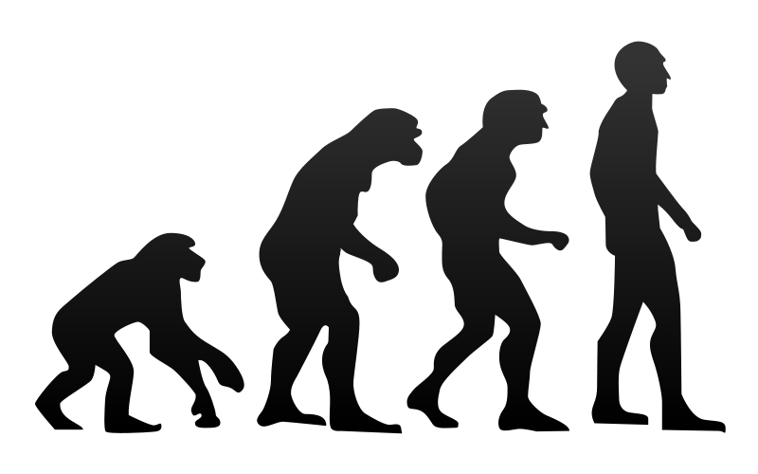

EVOLUTION OF DATA
APPLICATIONS
Notes:
Integration/batch

Slide 2

MONOLITHS
Notes:
Tight coupling between data models and business logic
Operationally hard to deploy/troubleshoot/etc
Delayed time to market

Slide 3



EXISTING
INTEGRATION AND BATCH

Slide 4


DATA
MICROSERVICES

Slide 5


CLOUD
NATIVE

Slide 6

DEVELOPED AND TESTED
IN ISOLATION

Slide 7

OPERATIONALLY EASY TO
GOVERN

Slide 8

DATA INTEGRATION
AS A SERVICE

Slide 9

COMPOSTION OF
MICROSERVICES

Slide 10
<?xml version="1.0" encoding="UTF-8"?> <beans xmlns="http://www.springframework.org/schema/beans" xmlns:xsi="http://www.w3.org/2001/XMLSchema-instance" xsi:schemaLocation="http://www.springframework.org/schema/batch http://www.springframework.org/schema/batch/spring-batch.xsd http://www.springframework.org/schema/beans http://www.springframework.org/schema/beans/spring-beans.xsd"> <job id="ioSampleJob" xmlns="http://www.springframework.org/schema/batch"> <step id="step1"> <tasklet> <chunk reader="itemReader" processor="itemProcessor" writer="itemWriter" commit-interval="2" /> </tasklet> </step> </job> <bean id="itemProcessor" class="org.springframework.batch.sample.domain.trade.internal.CustomerCreditIncreaseProcessor" /> </beans>
ZERO CODING

Slide 11

OPERATIONAL AND
ORCHESTRATION COVERAGE

Slide 12

SPRING XD
EXTREME DATA

Slide 13


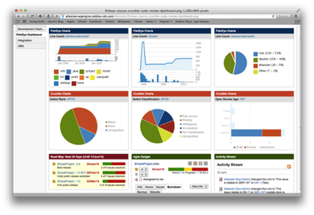





Ingestion
Orchestration
SPRING
Extraction
Real-time
Analytics
Notes:
Spring XD handles everything in the circle

Slide 14

DISTRIBUTED
RUNTIME

Slide 15
&
STREAMING
BATCH

Slide 16
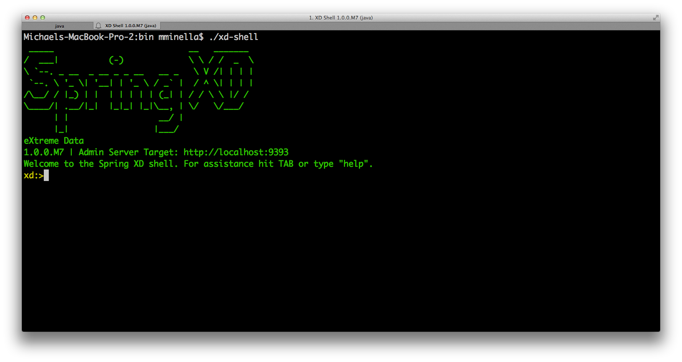

Slide 17
// Ingestion Stream Definitions
http | filter | acmeenrich | shell | hdfs

Slide 18
// Tap Definitions
IoT-HTTP.shell > typeconversiontransformer |
gemfire-server

Slide 19
SPRING CLOUD
DATA FLOW

Slide 20
SPRING XD
VERSION 2.0

Slide 21

SPRING CLOUD
STREAM
SPRING CLOUD
TASK

Slide 22

DECOMPOSE INTO BOOT
MICROSERVICES

Slide 23
SPRING CLOUD STREAM
HANDLES MESSAGING

Slide 24
SPRING CLOUD TASK
HANDLES STATE

Slide 25

Notes:
Introductions

Slide 26
BATCH ON
CLOUDFOUNDRY

Slide 27
A BRIEF INTRO
TO BATCH

Slide 28

Batch processing, … is defined as the
processing of a finite amount of data
without interaction or interruption.

Slide 29
1
REPORT GENERATION

Slide 30
2
ETL PROCESSING

Slide 31
3
DATA SCIENCE

Slide 32
4
BIG DATA
Notes:
INGEST
EXTRACT
ORCHESTRATION

Slide 33
Step1
Step2
Step3
ItemReader
Tasklet
ItemReader
ItemProcessor
ItemProcessor
ItemWriter
ItemWriter

Slide 34
CHALLENGES OF
BATCH ON CLOUDFOUNDRY

Slide 35
WHERE DO I
GET MY DATA?

Slide 36
1
SERVICES FOR REMOTE

Slide 37
2
GET IT WHEN YOU NEED IT

Slide 38
HOW DO I
ORCHESTRATE MY JOBS?

Slide 39

TODAY

Slide 40

THE FUTURE

Slide 41
SPRING CLOUD
DATA FLOW

Slide 42

WARS AND
APP SERVERS

Slide 43
DECOMPOSE INTO BOOT
MICROSERVICES

Slide 44
SPRING CLOUD
STREAMS

Slide 45
SPRING CLOUD
DATA FLOW

Slide 46
Data Integration as a Service
Traditional Apps
Data Microservices
Existing Enterprise SI/SB
Existing SI/SB workload dissected into distributed cloud native spring boot apps
A scalable service for real-time stream and batch based data pipelines.
Tight coupling between data models and business domains
Operationally hard to deploy, scale, troubleshoot, or monitor
Delays time to market
Develop, test, and deploy in isolation
Apply modern microservices patterns including composition and messaging
Operationally easy to govern
Streams or jobs as compositions of message driven microservices
Declaritive DSL to create data-centric pipelines; zero coding for common use-cases
Complete operational and orchestration coverage

Slide 47


Slide 48

Learn More. Stay Connected.
Pivotal: pivotal.io
Twitter: twitter.com/springcentral
YouTube: spring.io/video
LinkedIn: spring.io/linkedin
Google Plus: spring.io/gplus
Spring Cloud Streams
Project: spring.io/spring-cloud
Github: github.com/spring-cloud/spring-cloud-streams
Jira: jira.spring.io/browse/XD
Spring Boot
Project: spring.io/spring-boot
Github: github.com/spring-projects/spring-boot
Spring XD
Project: spring.io/spring-xd
Github: github.com/spring-projects/spring-xd
Jira: jira.spring.io/browse/XD

Slide 49







Notes:
https://commons.wikimedia.org/wiki/File:Human_evolution.svg

Slide 50

The
End

Slide 51
